Slide 1
An Evolution of a Mindset: A Historical Perspective on Sandia National Laboratories Fire Science Philosophy
Stanford ICME Seminar Series
January 30th, 2020 Stanford University
Stefan Domino, Ph.D.
Computational Thermal & Fluid Mechanics
Sandia National Laboratories SAND2019-15457 PE

Slide 2
Presentation Objectives
Pool Fire Heat Transfer Mechanisms
Physics Overview
Evolution from Quiescent, to Crossflow, to Whirling
Turbulence Modeling Choices
Solution Verification Concepts Demonstrated
Coupling and Discretization Overview
Conclusions
Interleaved Research Thrust Concepts:
Fire Dynamics in Crossflow
Automatic Structural Uncertainty Approaches
Quality generalized unstructured numerics
Extreme-scale computing
Machine Learning for Wall-Modeled Large-Eddy Simulation (LES)

Slide 3
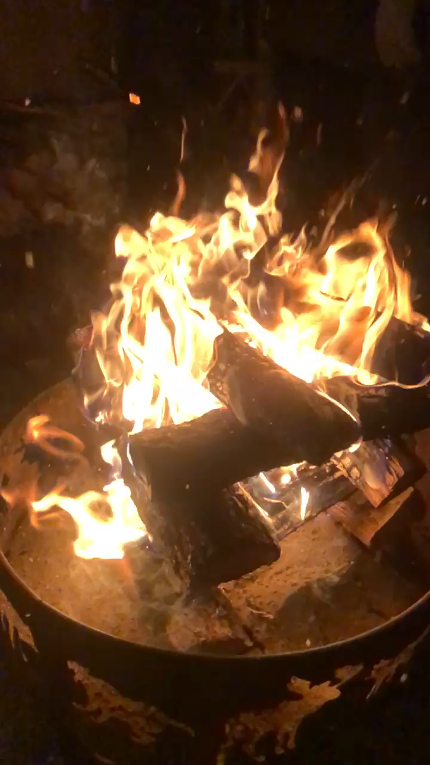
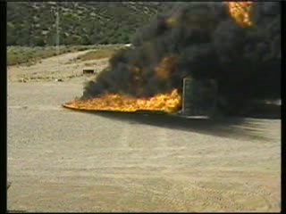
To be Human is to Intuitively Understand the Dynamics of Fire
Evidence of cooked food dates back ~two million years, Gowlett and Wrangham Azania: Archaeological Research in Africa, 2013
The first example of controlled fire usage could date back ~one million years, Bowman et al., Science, 2009
Widespread evidence of usage ~100,000 years ago
Therefore, humans have an innate understanding of how fire sounds, feels, and behaves
Intermittent wind gust
Fire feature soot plating
(Monterey, CA)
Luminaria (Santa Fe, NM)
10 meter outdoor fire (Nikos)

Slide 4
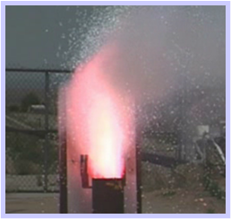
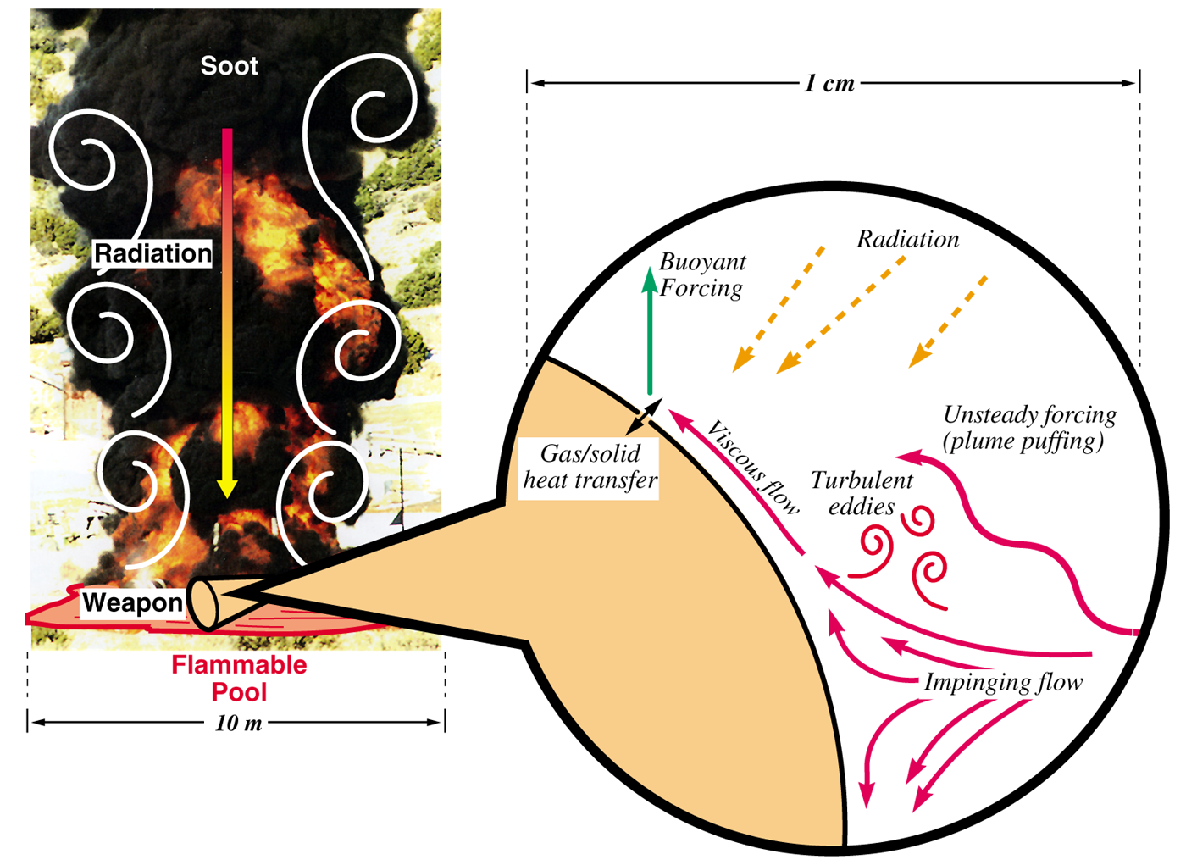
Heat Transfer Mechanisms: Abnormal/Thermal Environment (ATE)
Characterized by a highly sooting, turbulent reacting flow with participating media radiation (PMR) and conjugate heat transfer (CHT) multi-physics coupling
Liquid fuels, e.g., JP-8, are common due to its usage in transportation, however, propellants (point-Lagrangian/Eulerian) and composite (heterogeneous combustion) also encompass the ATE
Propellant upward burn
[1]
object
[1] https://en.wikipedia.org/wiki/2008_Andersen_Air_Force_Base_B-2_accident
Anderson Air Force B-2 Accident (2/2008)

Slide 5
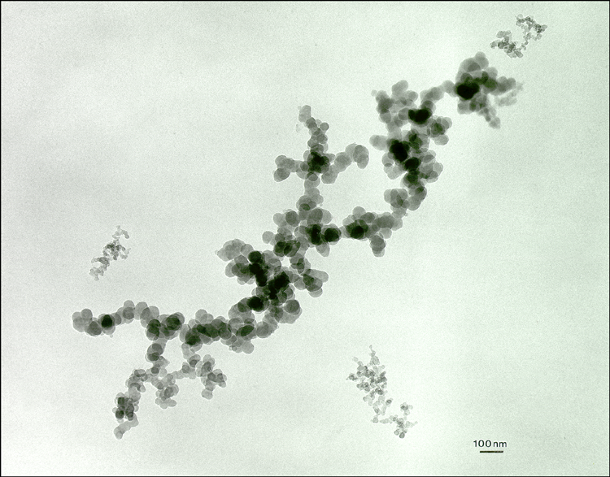
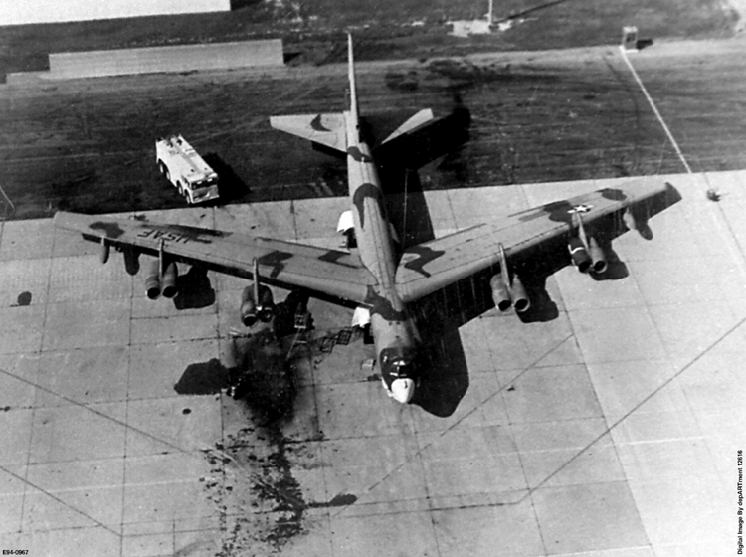
Grand Challenge: Vast Disparity in Time- and Length-Scales
Engineering Scale of Interest
10³
Heat Transfer in Weapon
Convective Transport
10⁰
Convection
Time Scale, seconds
Products
10⁻³
Fuel Distribution
Soot
Flames
10⁻⁶
Soot Radiation
Chemical Kinetics
Diffusive Transport
Soot Growth
10⁻⁹
Molecular Radiation
Molecular Transport
10⁻¹²
10⁻¹⁰
10⁻⁸
10⁻⁶
10⁻⁴
10⁻²
10⁰
10²
Length Scale, meters

Slide 6
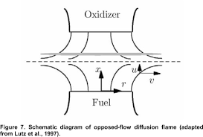
Evolution of a Mindset …. Quiescence
“There is no better, there is no more open door by which you can enter into the study of natural philosophy, than by considering the physical phenomena of a candle”
The Chemical History of a Candle, Michael Faraday (1791-1867)
“In the middle of the flame, where the wick is, there is this combustible vapor; on the outside of the flame is the air which we shall find necessary for the burning of the candle”
O_{x}
Q:
F
FLAME facility
O’Hern et al., JFM, 2005
Tieszen et al., C&F 2002
ODF; Martins et al, 2005

Slide 7
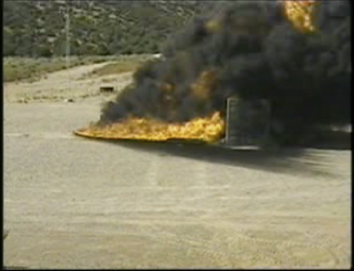
Evolution of a Mindset: From Simple to Complex
Peak radiative heat fluxes to engulfed objects is a function of fuel type, pool size, obstructions/accident geometry, and presence of crossflow
As crossflow and geometric complexity of accident scenarios increase, SNL has found that transitioning from a Reynolds-Averaged Navier-Stokes (RANS) to a more predictive large-eddy simulation (LES) approach is required → HPC on Next-Gen platforms (NGP)
RANS-based
LES-based
Quiescent; q”_{r}
~ 100 kW/m²
Cross-flow; q”_{r}
~ 200 kW/m²
Whirls
>> 200 kW/m²

Slide 8
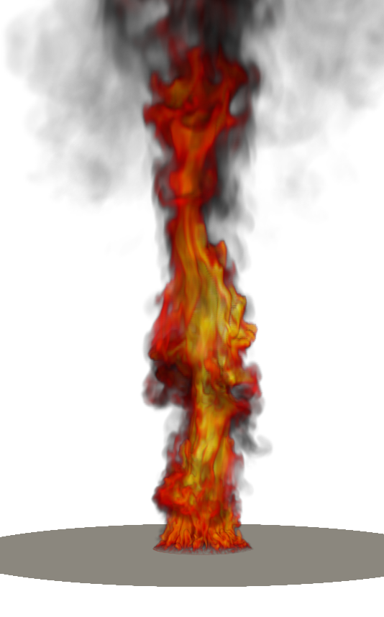
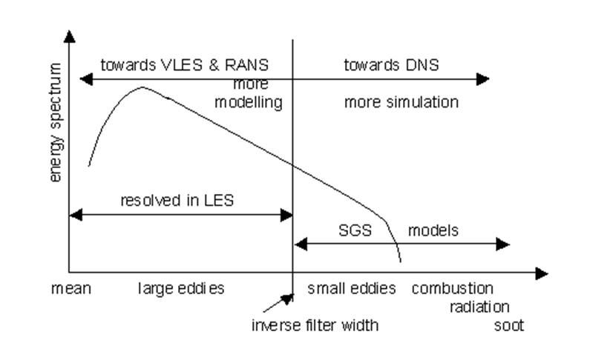

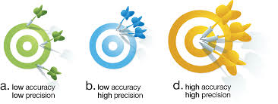
Choice of Turbulence Modeling
Direct Numerical Simulation (DNS), Large Eddy Simulation (LES) and Reynolds-Averaged Navier-Stokes (RANS) approaches define the computationally required time- and length scales
Pool Fire Use-Case: large length and time scales challenge compute platforms
1 cm resolution for a ten meter pool fire would require ~1 billion elements (only to a height of 1D)
1 mm ~ 1 trillion elements (neglects bluff body requirements)
Direct Numerical Simulation:
Simulation captures all relevant length- and time-scales
No turbulence modeling
Very expensive; total cost ~Re³
Large Eddy Simulation
Resolve the large-scale motion that contains most of the flow’s energy
Model small scale based on scale- similarity
Model = f(D)
Reynolds-Averaged Navier-Stokes
Model the turbulence spectrum
Empirical in nature
[1]
[1] https://sites.google.com/site/smokeisnojoke/lesrans2.jpg

Slide 9
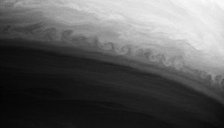
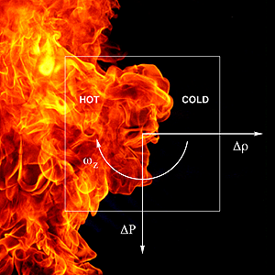
Fires/Plumes in Quiescent Conditions: The classic Abnormal/Thermal Environment (circa 1990)
Quiescent pool fires are, essentially, large-scale diffusion flames, i.e., mixing limited non-premixed combustion
Several instabilities dominate, including Rayleigh/Taylor (bubble spike, heavy on light fluid) and Kelvin Helmholtz (velocity shear between two streams)
[1]
Time-averaged (inset transient)
Vorticity generation (baroclinic torque), Rayleigh Taylor (RT) and
Kelvin Helmholtz(KH) instabilities are present
[1] https://en.wikipedia.org/wiki/Kelvin–Helmholtz_instability
Notes:
https://en.wikipedia.org/wiki/Kelvin–Helmholtz_instability: A KH instability on the planet Saturn, formed at the interaction of two bands of the planet's atmosphere

Slide 10
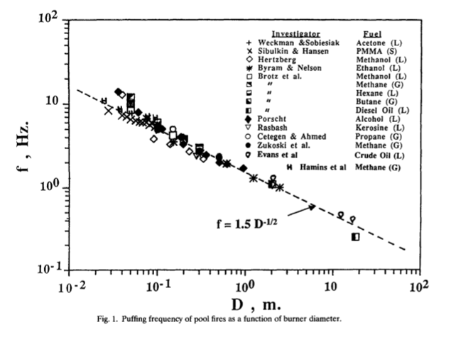
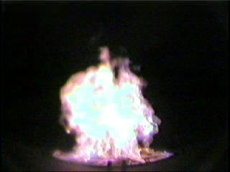
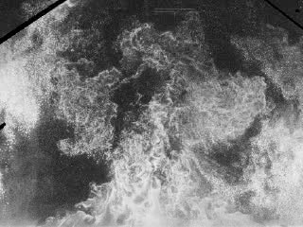
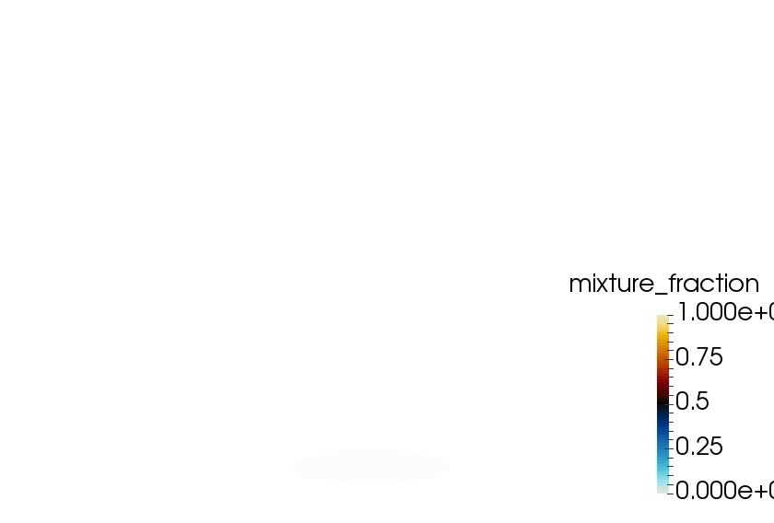
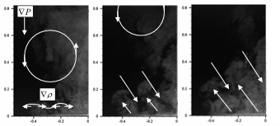
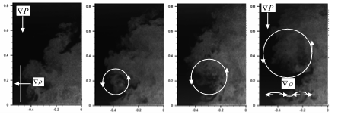
Quiescent Fire/Plume Physics
Fires, just as all buoyant plumes, in quiescent conditions “puff”
In this application space, radiative heat transfer dominates
Cetegen and Ahmed, C&F 1993
Hydrogen, Tieszen et al., C&F, 2004
Helium, O’Hern et al., JFM, 2005
Helium DNS, Domino, (unpublished) 2016
Evolution of a Puff Cycle (O’Hern et al., JFM, 2005)

